Slide 1
PRESENTATION ON SOFTWARE TESTING FOR TEST
CASE DESIGN
NAME:AMBARAPU RAVI
DEPT :CSE
SUBJECT CODE:CSA3724
TOPIC:ONLINE JOBS FOR LOGIN METHOD
REG NO:192111610

Slide 2
AIM:
TO IDENTIFY AND ANALYZE THE REQUIRMENTS FOR LOGIN MODEL OF ONLINE JOBS

Slide 3
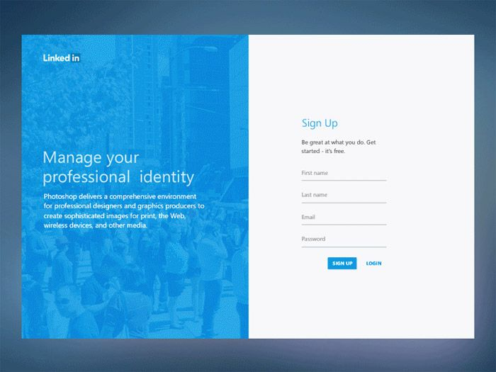

Slide 4
REQUIRMENTS:
USER NAME
PASSWORD
LOGIN ID
EMAIL ID
MOBILE NUMBER
LOGIN MODEL

Slide 5
TEST SCENARIO
Verify the messages for each mandatory field.
Verify if the user cannot proceed without filling all the mandatory fields.
Verify the age of the user when the DOB is selected.
Verify if the numbers and special characters are not allowed in the First and Last name.
Verify if a user can sign-up successfully with all the mandatory details.
Verify if a user can log in with the valid details.
Verify if the Password and Confirm Password fields are accepting similar strings only.
Verify if the Password field will prompt you for the weak passwords.
Verify if duplicate email address will not get assigned.
Verify that hints are provided for each field on the form, for the ease of use.

Slide 6
POSITIVE TEST CASES
Verify the a user will be able to login with a valid password
Verify the forgot password functionality
Verify the message for invalid login
Verify if the data password field is either visible as asterisk he/she changed the password
Verify the login page allows to log in simultaneously with different credentials in a different browoser
Verify if the enter key of the keyboard is working correctly on the login page
Verify if a user cannot enter the characters more than the specified range in each field
Verify the implementation of ssl certificate

Slide 7
NEGATIVE TEST CASES
Verify if a user cannot login with a valid username and an invalid password
Verify the login page for both when the field is blank and submit button is clicked
Verify if a user cannot enter the characters more than the specified range in each field
Verify the login page by pressing black button of the browoser it should not allow you to enter into the system once you log out
Verify if a user should not be allowed to log in with different credentials from the same browoser at the same time
Verify the login page against sql injection attack

Slide 8


